Slide 1
CS492 - Operating Systems
Introduction to Operating Systems
Georgios Portokalidis & Jun Xu
Reading: Zybook Ch 1.1, MOS Ch 1.1
Slides credit: Antonio Barbalace

Slide 2
Content
What is an OS?
Where does the OS fit in?
What are its main functions?
What can I consider an OS?

Slide 3
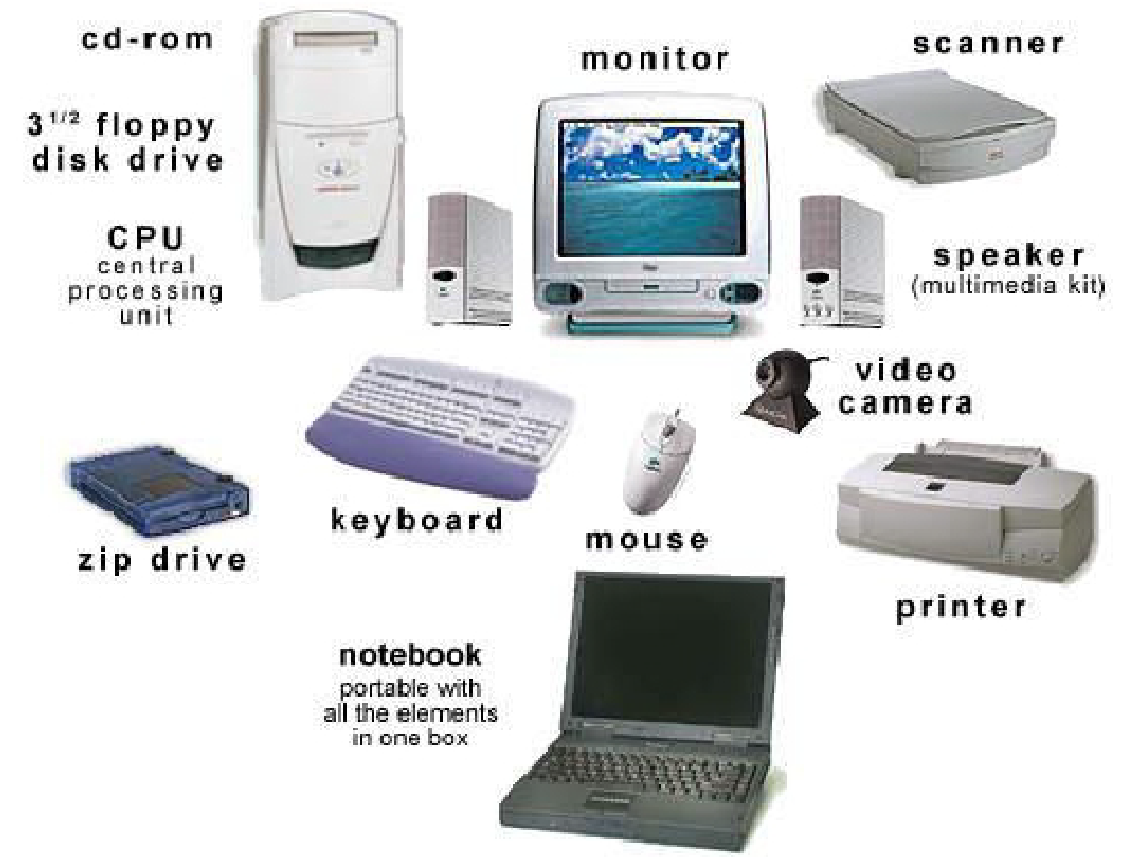
General Concepts
A computer system used to have many types of devices

Slide 4
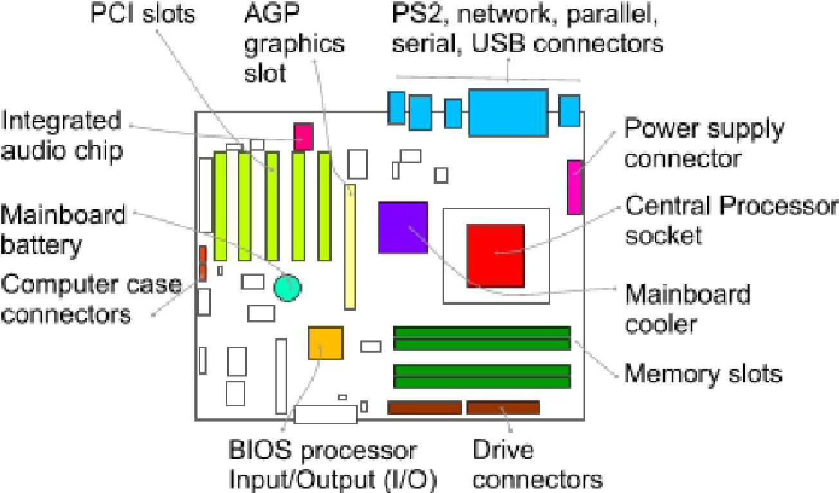
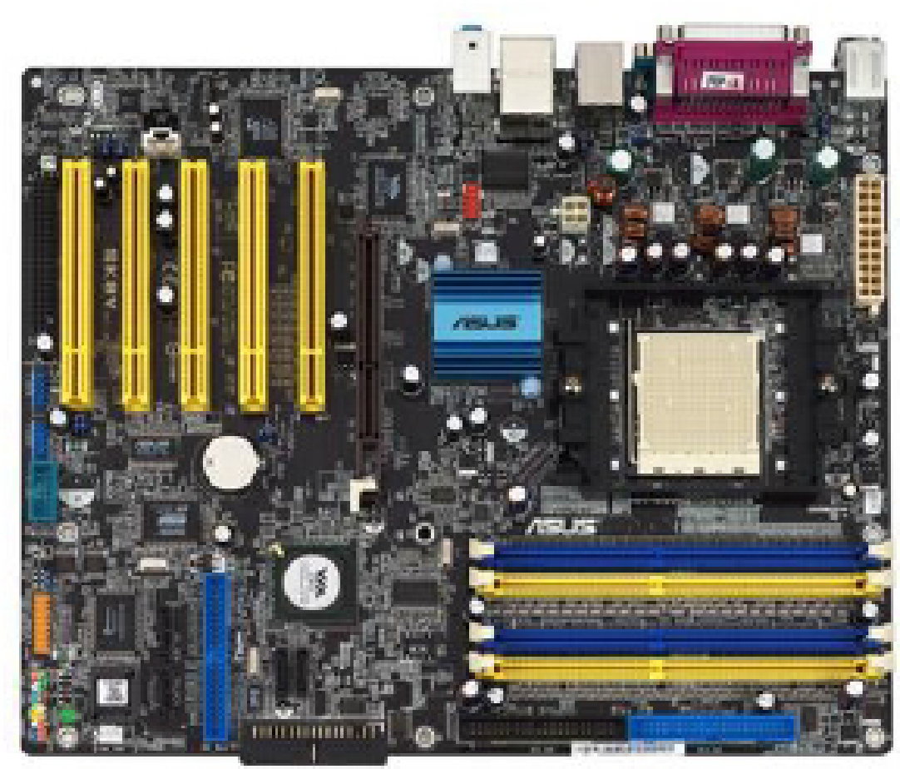
Inside the Box

Slide 5
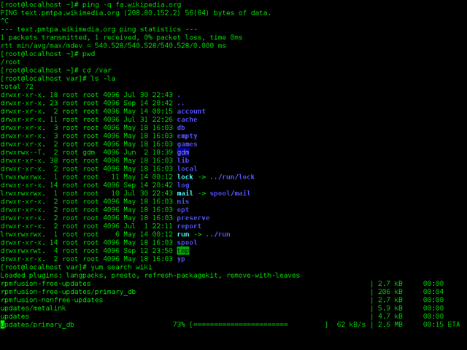
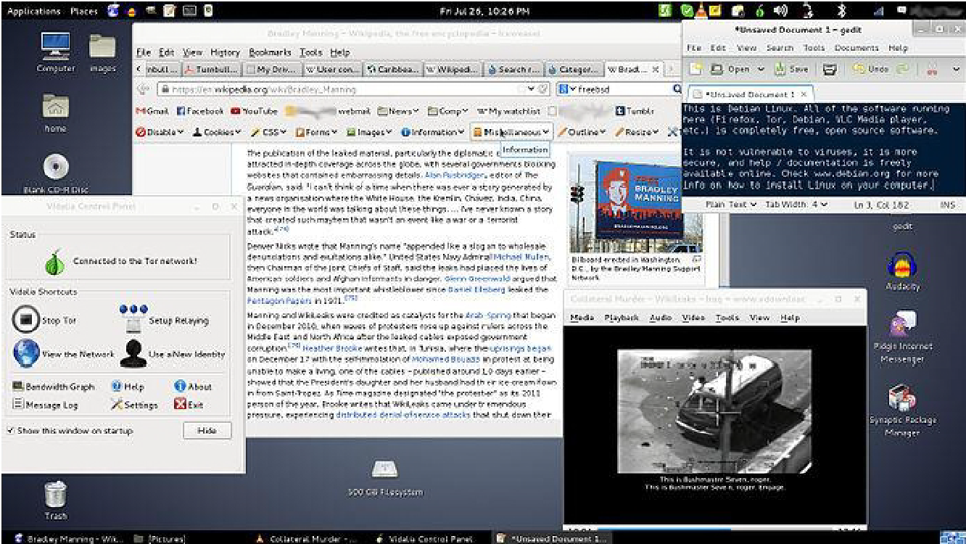
User Views
User Interface Programs (GUI, shell)

Slide 6
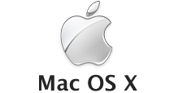

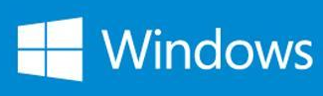




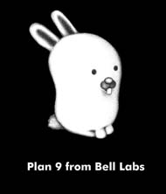


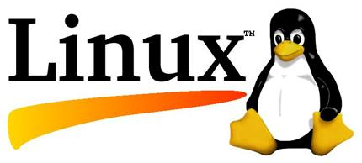


Operating Systems
MS-DOS
Notes:
Fish is OpenBSD
Devil is FreeBSD
Dragonfly is DragonFlyBSD
Red bird is illumos

Slide 7
What is an Operating System?
A modern computer consists of
  One or more processors
  Main memory
  Disks
  Various input/output devices
Managing all these components requires a layer of software
  The Operating System (OS)

Slide 8
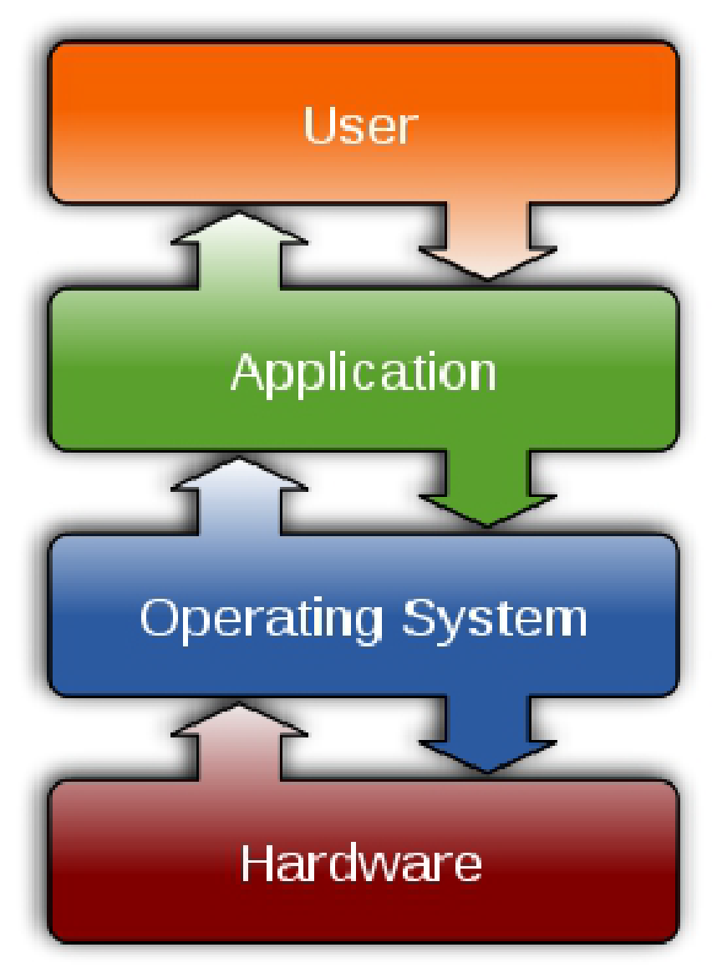
Where the OS Fits In … (1)
Software

Slide 9
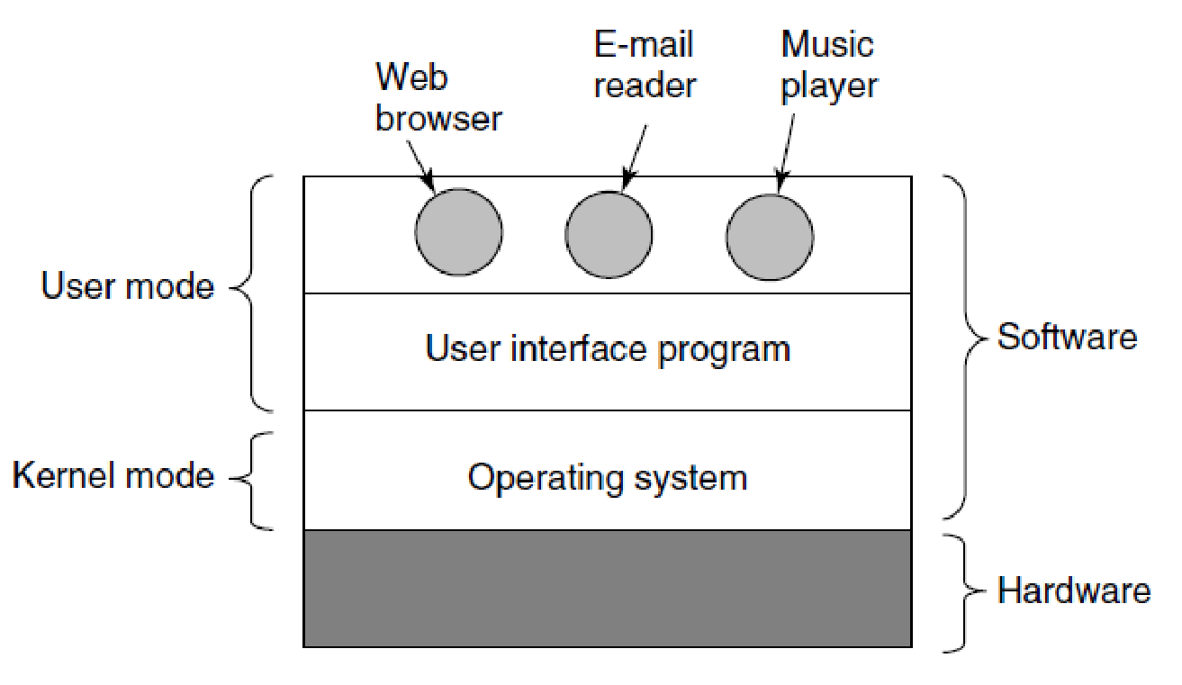
Where the OS Fits In … (2)
Where the operating system fits in (MOS Figure 1-1)

Slide 10
Operating System Functions
Extended machine (top-down view)
Resource manager (bottom-up view)
Device-management functionality
Operating system services

Slide 11
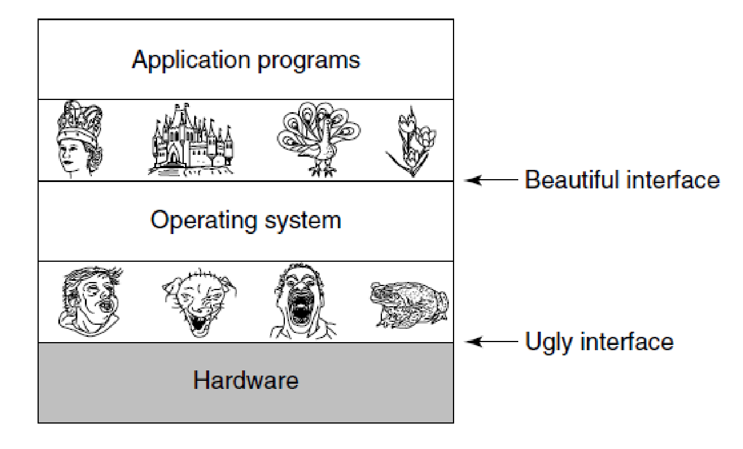
The OS as an Extended Machine
Operating systems turn ugly hardware into beautiful abstractions (MOS Figure 1-2)
Notes:
TOP-DOWN
BOOK:
To make this point more concrete, consider
modern SATA (Serial ATA) hard disks used on most computers. A book (Anderson,
2007) describing an early version of the interface to the disk—what a programmer
would have to know to use the disk—ran over 450 pages. Since then, the
interface has been revised multiple times and is more complicated than it was in
2007. Clearly, no sane programmer would want to deal with this disk at the hardware
level. Instead, a piece of software, called a disk driver, deals with the hardware
and provides an interface to read and write disk blocks, without getting into
the details. Operating systems contain many drivers for controlling I/O devices.
But even this level is much too low for most applications. For this reason, all
operating systems provide yet another layer of abstraction for using disks: files.
Using this abstraction, programs can create, write, and read files, without having to
deal with the messy details of how the hardware actually works.
This abstraction is the key to managing all this complexity. Good abstractions
turn a nearly impossible task into two manageable ones. The first is defining and
implementing the abstractions. The second is using these abstractions to solve the
problem at hand. One abstraction that almost every computer user understands is
the file, as mentioned above. It is a useful piece of information, such as a digital
photo, saved email message, song, or Web page. It is much easier to deal with photos,
emails, songs, and Web pages than with the details of SATA (or other) disks.
The job of the operating system is to create good abstractions and then implement
and manage the abstract objects thus created. In this book, we will talk a lot about
abstractions. They are one of the keys to understanding operating systems.
This point is so important that it is worth repeating in different words. With all
due respect to the industrial engineers who so carefully designed the Macintosh,
hardware is ugly. Real processors, memories, disks, and other devices are very
complicated and present difficult, awkward, idiosyncratic, and inconsistent interfaces
to the people who have to write software to use them. Sometimes this is due
to the need for backward compatibility with older hardware. Other times it is an
attempt to save money. Often, however, the hardware designers do not realize (or
care) how much trouble they are causing for the software. One of the major tasks
of the operating system is to hide the hardware and present programs (and their
programmers) with nice, clean, elegant, consistent, abstractions to work with instead.
Operating systems turn the ugly into the beautiful, as shown in Fig. 1-2.
It should be noted that the operating system’s real customers are the application
programs (via the application programmers, of course). They are the ones
who deal directly with the operating system and its abstractions. In contrast, end
users deal with the abstractions provided by the user interface, either a command-
line shell or a graphical interface. While the abstractions at the user interface
may be similar to the ones provided by the operating system, this is not always the
case. To make this point clearer, consider the normal Windows desktop and the
line-oriented command prompt. Both are programs running on the Windows operating
system and use the abstractions Windows provides, but they offer very different
user interfaces. Similarly, a Linux user running Gnome or KDE sees a very
different interface than a Linux user working directly on top of the underlying X
Window System, but the underlying operating system abstractions are the same in
both cases.

Slide 12
The OS as a Resource Manager
Allow multiple programs to run at the same time
Manage and protect memory, I/O devices, and other resources
Multiplex (share) resources in two different ways
  In time
  In space
Notes:
BOTTOM-UP
BOOK:
An alternative, bottom-up, view holds that
the operating system is there to manage all the pieces of a complex system. Modern
computers consist of processors, memories, timers, disks, mice, network interfaces,
printers, and a wide variety of other devices. In the bottom-up view, the job
of the operating system is to provide for an orderly and controlled allocation of the
processors, memories, and I/O devices among the various programs wanting them.
Modern operating systems allow multiple programs to be in memory and run
at the same time. Imagine what would happen if three programs running on some
computer all tried to print their output simultaneously on the same printer. The first
few lines of printout might be from program 1, the next few from program 2, then
some from program 3, and so forth. The result would be utter chaos. The operating
system can bring order to the potential chaos by buffering all the output destined
for the printer on the disk. When one program is finished, the operating system can
then copy its output from the disk file where it has been stored for the printer,
while at the same time the other program can continue generating more output,
oblivious to the fact that the output is not really going to the printer (yet).
When a computer (or network) has more than one user, the need for managing
and protecting the memory, I/O devices, and other resources is even more since the
users might otherwise interfere with one another. In addition, users often need to
share not only hardware, but information (files, databases, etc.) as well. In short,
this view of the operating system holds that its primary task is to keep track of
which programs are using which resource, to grant resource requests, to account
for usage, and to mediate conflicting requests from different programs and users.
Resource management includes multiplexing (sharing) resources in two different
ways: in time and in space. When a resource is time multiplexed, different
programs or users take turns using it. First one of them gets to use the resource,
then another, and so on. For example, with only one CPU and multiple programs
that want to run on it, the operating system first allocates the CPU to one program,
then, after it has run long enough, another program gets to use the CPU, then another,
and then eventually the first one again. Determining how the resource is time
multiplexed—who goes next and for how long—is the task of the operating system.
Another example of time multiplexing is sharing the printer. When multiple
print jobs are queued up for printing on a single printer, a decision has to be made
about which one is to be printed next.
The other kind of multiplexing is space multiplexing. Instead of the customers
taking turns, each one gets part of the resource. For example, main memory is normally
divided up among several running programs, so each one can be resident at
the same time (for example, in order to take turns using the CPU). Assuming there
is enough memory to hold multiple programs, it is more efficient to hold several
programs in memory at once rather than give one of them all of it, especially if it
only needs a small fraction of the total. Of course, this raises issues of fairness,
protection, and so on, and it is up to the operating system to solve them. Another
resource that is space multiplexed is the disk. In many systems a single disk can
hold files from many users at the same time. Allocating disk space and keeping
track of who is using which disk blocks is a typical operating system task.

Slide 13
What is an OS? (1)
Application
Compiler
Runtime Libraries
User Interface
System Software
Core Runtime Libraries
Operating System
Kernel
Kernel Ext
Kernel Ext
Hypervisor/Virtual Machine Monitor
Hardware

Slide 14
What is an OS? (2)
Application
User
mode
(Unprivileged mode)
Compiler
Runtime Libraries
User Interface
Core Runtime Libraries
Operating System
Kernel
mode
(Privileged mode, Supervisor mode)
Kernel
Kernel Ext
Kernel Ext
Hypervisor/Virtual Machine Monitor
NOTE there exist OSes that do not use modes, there is hardware that doesn’t support modes
Notes:
On top of the hardware is the software. Most computers have two modes of operation: kernel mode and user mode. The operating system, the most fundamental piece of software, runs in kernel mode (also called supervisor mode). In this mode it has complete access to all the hardware and can execute any instruction the machine is capable of executing. The rest of the software runs in user mode, in which only a subset of the machine instructions is available. In particular, those instructions that affect control of the machine or do I/O )Input/Output" are forbidden to user-mode programs. We will come back to the difference between kernel mode and user mode repeatedly throughout this book. It plays a crucial role in how operating systems works

Slide 15
This course will focus on the OS kernel

Slide 16
TODOs Before Next lecture
Study zyBook chapters 1.1-1.2
  Includes the chapter we covered today and the one we’ll cover on Wed
Complete relevant zyBook activities
  zyBook assignment “1-Introduction part1”

